Slide 1
Does Sex-Ed Legislation affect Abortion rates
Alexander Saunders

Slide 2
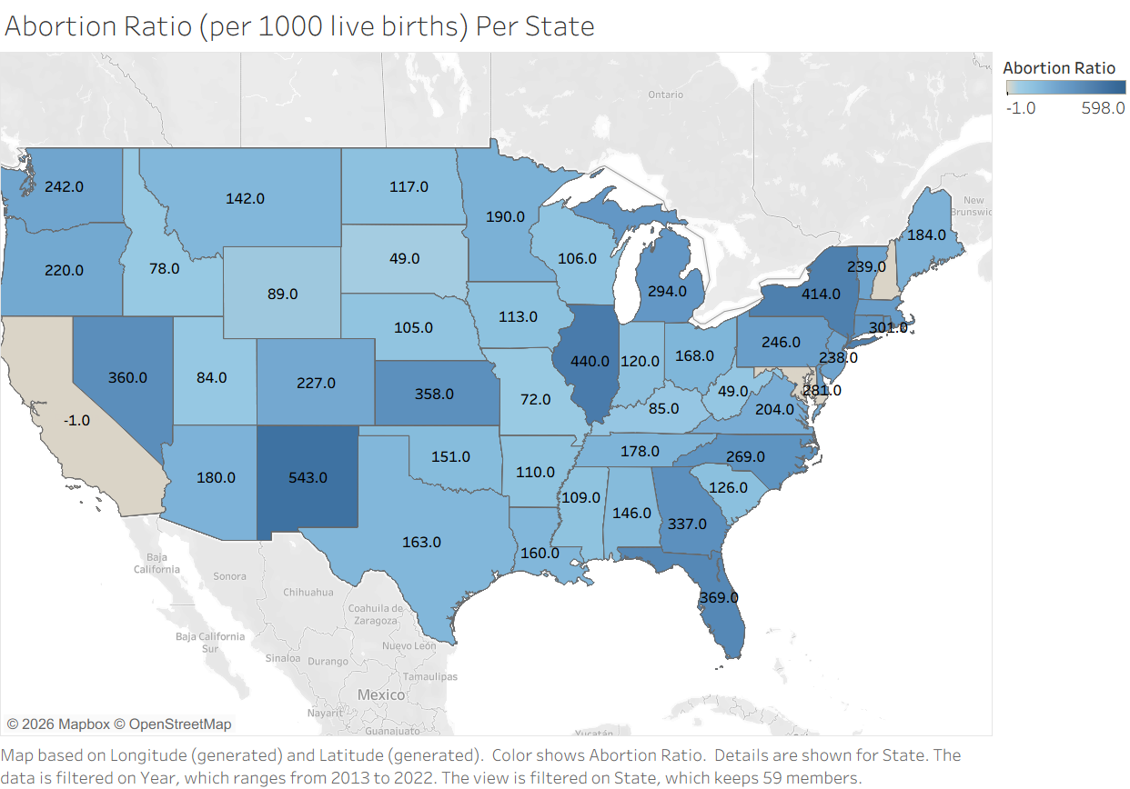

Slide 3
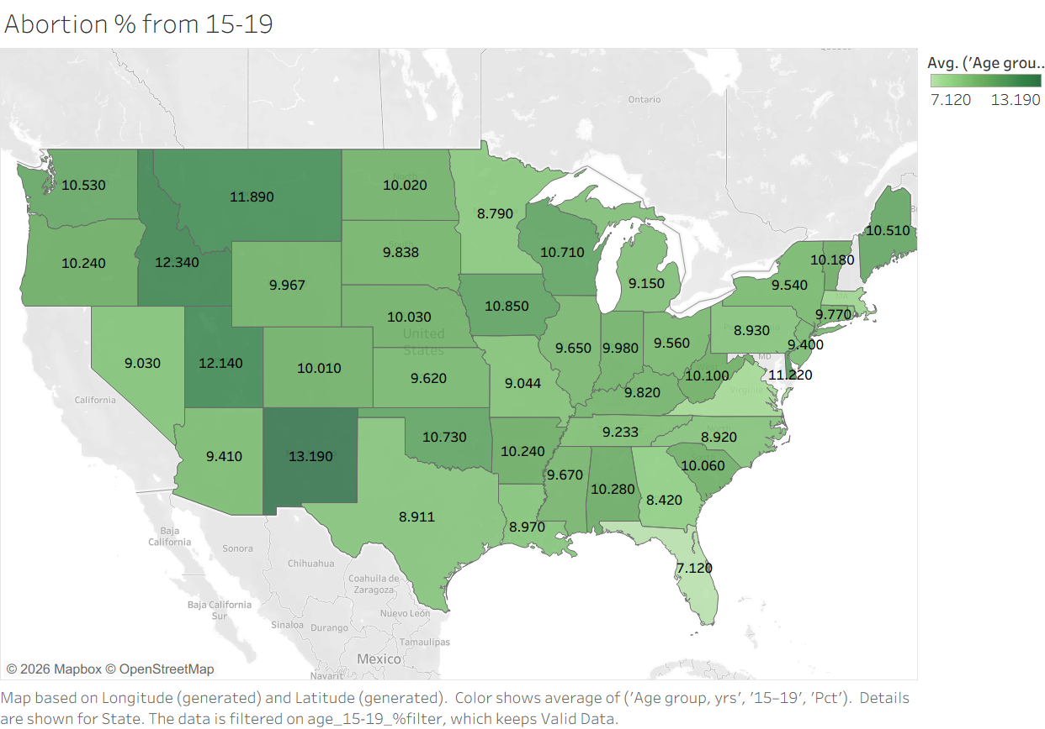

Slide 4
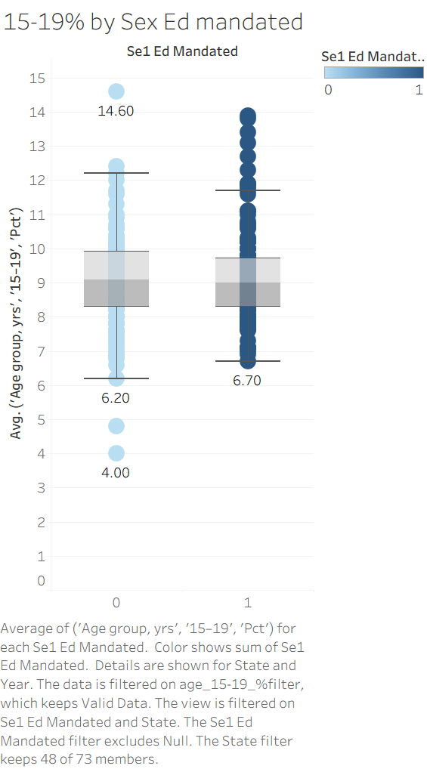

Slide 5




Slide 6
